Slide 1
HOSPITAL ECOSYSTEM
Nauka Atulkumar Salot
001619470

Slide 2
PROBLEM STATEMENT
Hospitals go through a complex chain of organizations. There are plenty of emergency cases getting registered at a hospital on a daily basis. So, the management of the staff and the doctors also gets difficult if no prior preparations have been made by the hospital. The process gets tedious and difficult to manage.
Even for the government, it becomes difficult to manage the number of ambulances as well as the drivers.

Slide 3
PROBLEM SOLUTION
For the hospital
By keeping a record of the emergency patients getting registered to the hospital, the hospital will be able to manage the staff, the emergency rooms, the doctors and the nurses in a better way and serve the patient well enough in the critical condition. From the insurance, to assigning a room in the hospital and managing the accounts of the patient becomes easy to handle.
For the government
By keeping a record of the emergency patients getting registered, the government can make better arrangements of the ambulance and the ambulance staff to serve the patients immediately.

Slide 4
ASSUMPTIONS
As we are dealing with the concept of “Internet of Things”, the people will be having a sensor on their body which will track their vital signs constantly and if any of the vital signs go below a minimum value, the request will be sent to the ambulance.
The ambulance will take the patient to the hospital.
The ambulance also has sensors and it is assumed that the ambulance only in that area will receive the request.

Slide 5
IOT Concept in my Project
There will be sensors attached to a person’s body which will constantly monitor the vital signs of the person. As soon as the vital signs go below the normal range, the request will be sent to the ambulance.
There are sensors attached to the ambulance as well, so, as soon as the request is sent by the person’s sensor, all the ambulances in that area will receive the request and then one of the drivers will assign the request to himself.

Slide 6
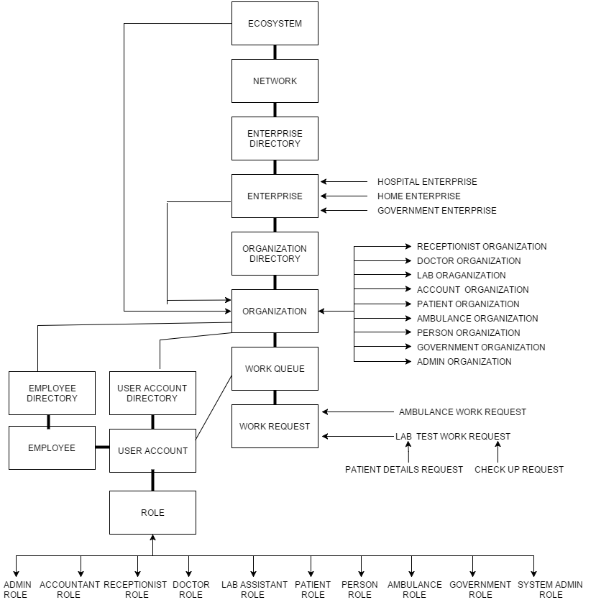
OBJECT
MODEL

Slide 7
Enterprises and Organizations
Hospital Enterprise
Receptionist Organization
Doctor Organization
Patient Organization
Lab Organization
Account Organization
Home Enterprise
Person Organization
Ambulance Organization
Government Enterprise
Government Organization

Slide 8
KEY ROLES
Receptionist Role:
The receptionist adds the patient, sends him to an appropriate doctor, assigns him a room in the hospital, takes the insurance details and manages the emergency cases.
Patient Role:
A patient is added by the receptionist.
Doctor Role:
A doctor processes the request sent by the receptionist and diagnoses the patient and requests the lab for a medical test.
Lab Assistant Role:
The lab assistant logs in to his work area, assigns himself the request sent by the doctor, processes the request and sends the result to the doctor.
Account Role:
The accountant keeps a record of patient’s all financial details and generates a bill.

Slide 9
Person Role:
There are sensors on the human body which constantly tracks the vital signs of the patient and if any of the vital signs go below the normal range, it will notify the ambulance by sending a request.
Ambulance Role:
The ambulance will receive the request sent by the person, assigns to himself, processes the request and takes the patient to the hospital.
Government Role:
The government official keeps the record of all the emergency cases registered in the area.

Slide 10
KEY FEATURES
To manage the patients effectively, send them to an appropriate doctor according to their problem, take care of the insurance and assign them a room in the hospital.
To take care of the emergency patients getting registered at the hospital and again perform the same process
The hospital also keeps a record of the number of emergency cases getting registered to the hospital, so from that data the hospital gets an idea about the management of the staff, doctors, rooms and nurses.
The government also keeps the record of all the emergency cases that got registered in the area and so by having a record, the government will be able to manage the ambulances and the ambulance drivers effectively and provide an immediate help.

Slide 11
EXTRA FEATURES
Email API
Text to Speech API

Slide 12
Thank You!

